Slide 1
COSC3503 Section 1 Operating Systems Chapter 10 Mass-Storage Structure
Doug Lim

Slide 2
Overview of Mass Storage Structure
Magnetic disks provide bulk of secondary storage of modern computers
Drives rotate at 60 to 250 times per second
Transfer rate is rate at which data flow between drive and computer
Positioning time (random-access time) is time to move disk arm to desired cylinder (seek time) and time for desired sector to rotate under the disk head (rotational latency)
Head crash results from disk head making contact with the disk surface -- That’s bad
Disks can be removable
Drive attached to computer via I/O bus
Busses vary, including EIDE, ATA, SATA, USB, Fibre Channel, SCSI, SAS, Firewire
Host controller in computer uses bus to talk to disk controller built into drive or storage array

Slide 3
Hard Disk Performance
Access Latency = Average access time = average seek time + average latency
For fastest disk 3ms + 2ms = 5ms
For slow disk 9ms + 5.56ms = 14.56ms
Average I/O time = average access time + (amount to transfer / transfer rate) + controller overhead
For example to transfer a 4KB block on a 7200 RPM disk with a 5ms average seek time, 1Gb/sec transfer rate with a .1ms controller overhead =
5ms + 4.17ms + 0.1ms + transfer time =
Transfer time = 4KB / 1Gb/s * 8Gb / GB * 1GB / 1024²KB = 32 / (1024²) = 0.031 ms
Average I/O time for 4KB block = 9.27ms + .031ms = 9.301ms

Slide 4
Solid-State Disks
Nonvolatile memory used like a hard drive
Many technology variations
Can be more reliable than HDDs
More expensive per MB
Maybe have shorter life span
Less capacity
But much faster
Busses can be too slow -> connect directly to PCI for example
No moving parts, so no seek time or rotational latency

Slide 5
Magnetic Tape
Was early secondary-storage medium
Evolved from open spools to cartridges
Relatively permanent and holds large quantities of data
Access time slow
Random access ~1000 times slower than disk
Mainly used for backup, storage of infrequently-used data, transfer medium between systems
Kept in spool and wound or rewound past read-write head
Once data under head, transfer rates comparable to disk
140MB/sec and greater
200GB to 1.5TB typical storage
Common technologies are LTO-{3,4,5} and T10000

Slide 6
Disk Structure
Disk drives are addressed as large 1-dimensional arrays of logical blocks, where the logical block is the smallest unit of transfer
Low-level formatting creates logical blocks on physical media
The 1-dimensional array of logical blocks is mapped into the sectors of the disk sequentially
Sector 0 is the first sector of the first track on the outermost cylinder
Mapping proceeds in order through that track, then the rest of the tracks in that cylinder, and then through the rest of the cylinders from outermost to innermost
Logical to physical address should be easy
Except for bad sectors
Non-constant # of sectors per track via constant angular velocity

Slide 7
Disk Attachment
Host-attached storage accessed through I/O ports talking to I/O busses
SCSI itself is a bus, up to 16 devices on one cable, SCSI initiator requests operation and SCSI targets perform tasks
Each target can have up to 8 logical units (disks attached to device controller)
FC is high-speed serial architecture
Can be switched fabric with 24-bit address space – the basis of storage area networks (SANs) in which many hosts attach to many storage units
I/O directed to bus ID, device ID, logical unit (LUN)

Slide 8
Storage Array
Can just attach disks, or arrays of disks
Storage Array has controller(s), provides features to attached host(s)
Ports to connect hosts to array
Memory, controlling software (sometimes NVRAM, etc)
A few to thousands of disks
RAID, hot spares, hot swap (discussed later)
Shared storage -> more efficiency
Features found in some file systems
Snaphots, clones, thin provisioning, replication, deduplication, etc

Slide 9
Storage Area Network
Common in large storage environments
Multiple hosts attached to multiple storage arrays – flexible
SAN is one or more storage arrays
Connected to one or more Fibre Channel switches
Hosts also attach to the switches
Storage made available via LUN Masking from specific arrays to specific servers
Easy to add or remove storage, add new host and allocate it storage
Over low-latency Fibre Channel fabric
Why have separate storage networks and communications networks?
Consider iSCSI, FCOE

Slide 10
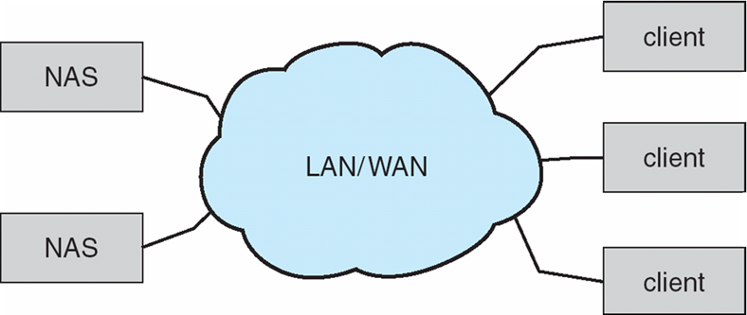
Network-Attached Storage
Network-attached storage (NAS) is storage made available over a network rather than over a local connection (such as a bus)
Remotely attaching to file systems
NFS and CIFS are common protocols
Implemented via remote procedure calls (RPCs) between host and storage over typically TCP or UDP on IP network
iSCSI protocol uses IP network to carry the SCSI protocol
Remotely attaching to devices (blocks)

Slide 11
Disk Scheduling
The operating system is responsible for using hardware efficiently — for the disk drives, this means having a fast access time and disk bandwidth
Minimize seek time
Seek time is approximately seek distance
Disk bandwidth is the total number of bytes transferred, divided by the total time between the first request for service and the completion of the last transfer
There are many sources of disk I/O request
OS
System processes
Users processes
I/O request includes input or output mode, disk address, memory address, number of sectors to transfer
OS maintains queue of requests, per disk or device
Idle disk can immediately work on I/O request, busy disk means work must queue
Optimization algorithms only make sense when a queue exists

Slide 12
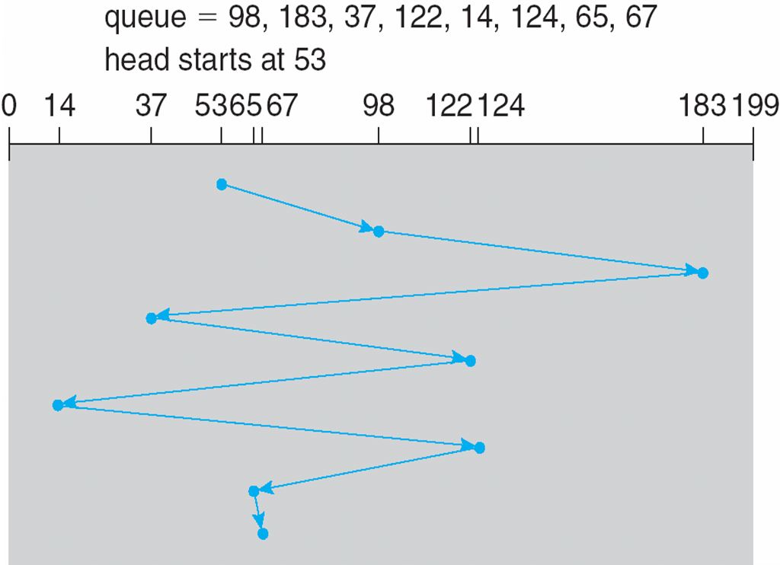
First Come First Serve (FCFS)

Slide 13
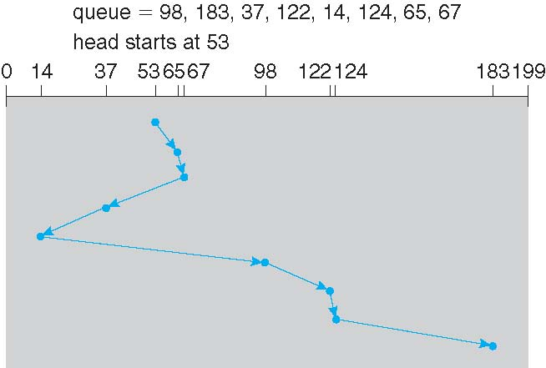
Shortest Seek Time First (SSTF)
Shortest Seek Time First selects the request with the minimum seek time from the current head position
SSTF scheduling is a form of SJF scheduling; may cause starvation of some requests
Illustration shows total head movement of 236 cylinders

Slide 14
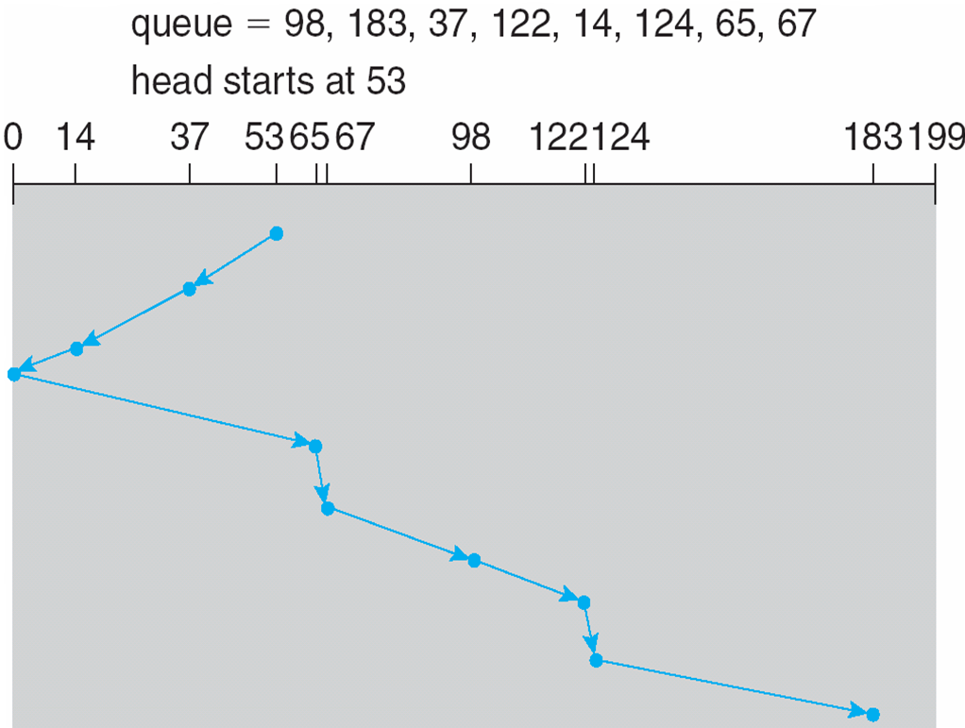
SCAN
The disk arm starts at one end of the disk, and moves toward the other end, servicing requests until it gets to the other end of the disk, where the head movement is reversed, and servicing continues.
SCAN algorithm Sometimes called the elevator algorithm
Illustration shows total head movement of 236 cylinders
But note that if requests are uniformly dense, largest density at other end of disk and those wait the longest

Slide 15
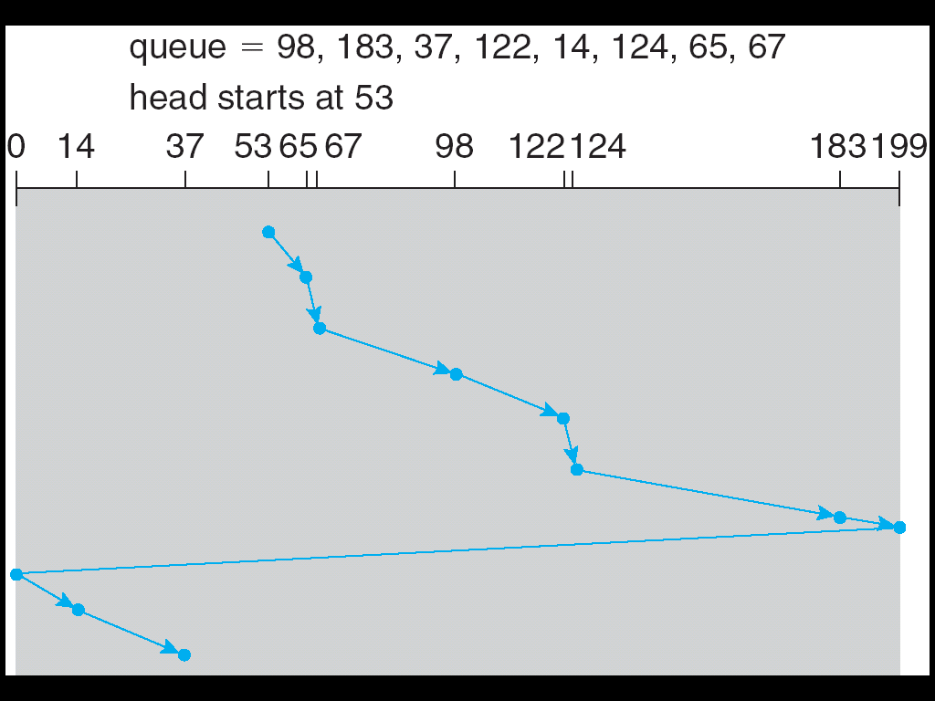
Circular Scan (C-SCAN)
Provides a more uniform wait time than SCAN
The head moves from one end of the disk to the other, servicing requests as it goes
When it reaches the other end, however, it immediately returns to the beginning of the disk, without servicing any requests on the return trip
Treats the cylinders as a circular list that wraps around from the last cylinder to the first one
Average wait time heavily dependent on the number of cylinders.

Slide 16
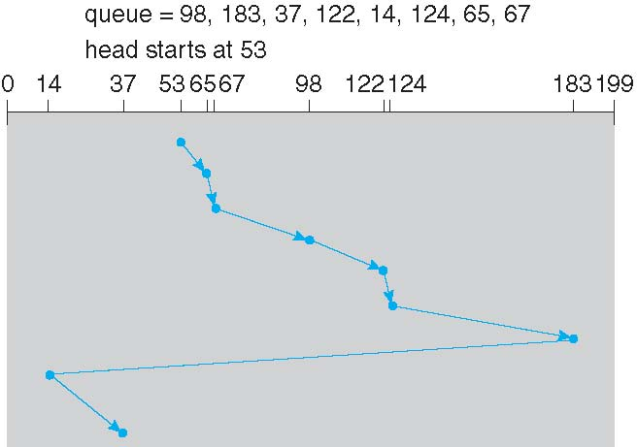
C-LOOK
LOOK a version of SCAN, C-LOOK a version of C-SCAN
Arm only goes as far as the last request in each direction, then reverses direction immediately, without first going all the way to the end of the disk

Slide 17
Selecting a Disk-Scheduling Algorithm
SSTF is common and has a natural appeal
SCAN and C-SCAN perform better for systems that place a heavy load on the disk
Less starvation
Performance depends on the number and types of requests
Requests for disk service can be influenced by the file-allocation method
And metadata layout
The disk-scheduling algorithm should be written as a separate module of the operating system, allowing it to be replaced with a different algorithm if necessary
Either SSTF or LOOK is a reasonable choice for the default algorithm
What about rotational latency?
Difficult for OS to calculate
How does disk-based queueing effect OS queue ordering efforts?

Slide 18
Disk Management
Low-level formatting, or physical formatting — Dividing a disk into sectors that the disk controller can read and write
Each sector can hold header information, plus data, plus error correction code (ECC)
Usually 512 bytes of data but can be selectable
To use a disk to hold files, the operating system still needs to record its own data structures on the disk
Partition the disk into one or more groups of cylinders, each treated as a logical disk
Logical formatting or “making a file system”
To increase efficiency most file systems group blocks into clusters
Disk I/O done in blocks
File I/O done in clusters
Raw disk access for apps that want to do their own block management, keep OS out of the way (databases for example)
Boot block initializes system
The bootstrap is stored in ROM
Bootstrap loader program stored in boot blocks of boot partition
Methods such as sector sparing used to handle bad blocks

Slide 19
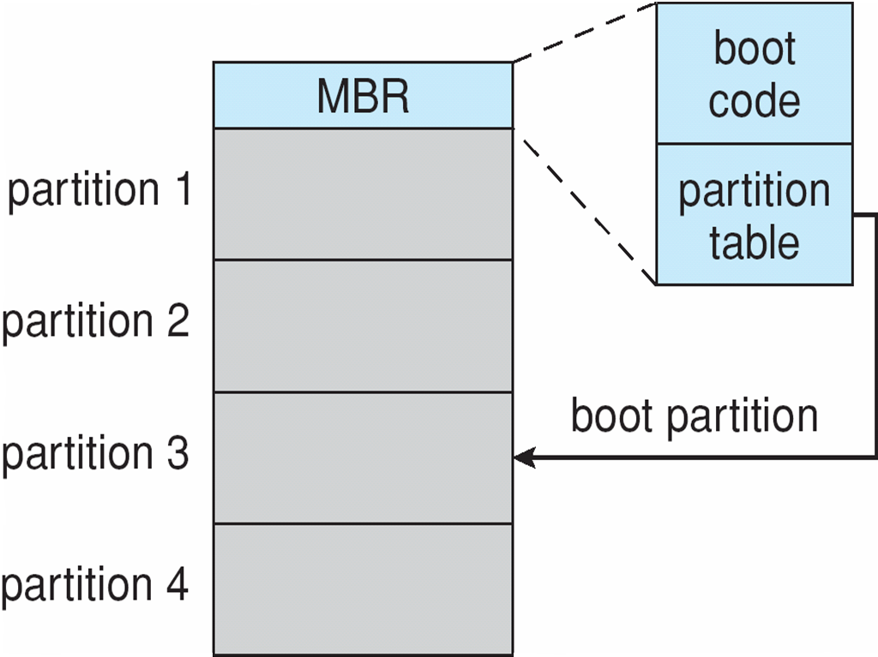
Booting from a Disk in Windows

Slide 20
RAID Structure
RAID – redundant array of inexpensive/independent disks
multiple disk drives provides reliability via redundancy
Increases the mean time to failure
Mean time to repair – exposure time when another failure could cause data loss
Mean time to data loss based on above factors
If mirrored disks fail independently, consider disk with 1300,000 mean time to failure and 10 hour mean time to repair
Mean time to data loss is 100, 000² / (2 ∗ 10) = 500 ∗ 10⁶ hours, or 57,000 years!
Frequently combined with NVRAM to improve write performance
Several improvements in disk-use techniques involve the use of multiple disks working cooperatively

Slide 21
RAID Techniques
Disk striping uses a group of disks as one storage unit
RAID is arranged into six different levels
RAID schemes improve performance and improve the reliability of the storage system by storing redundant data
Mirroring or shadowing (RAID 1) keeps duplicate of each disk
Striped mirrors (RAID 1+0) or mirrored stripes (RAID 0+1) provides high performance and high reliability
Block interleaved parity (RAID 4, 5, 6) uses much less redundancy
RAID within a storage array can still fail if the array fails, so automatic replication of the data between arrays is common
Frequently, a small number of hot-spare disks are left unallocated, automatically replacing a failed disk and having data rebuilt onto them

Slide 22
RAID ZFS Extensions
RAID alone does not prevent or detect data corruption or other errors, just disk failures
Solaris ZFS adds checksums of all data and metadata
Checksums kept with pointer to object, to detect if object is the right one and whether it changed
Can detect and correct data and metadata corruption
ZFS also removes volumes, partitions
Disks allocated in pools
Filesystems with a pool share that pool, use and release space like malloc() and free() memory allocate / release calls

